Slide 1
Organization Structure & Culture
(Ch. 3 – T1)
M K Hamirwasia
WILPD

Slide 2
AE ZG523/DE ZG523/ES ZG523/MM ZG523/POM ZG523-Merged
Project Management
Lecture No. 6

Slide 3
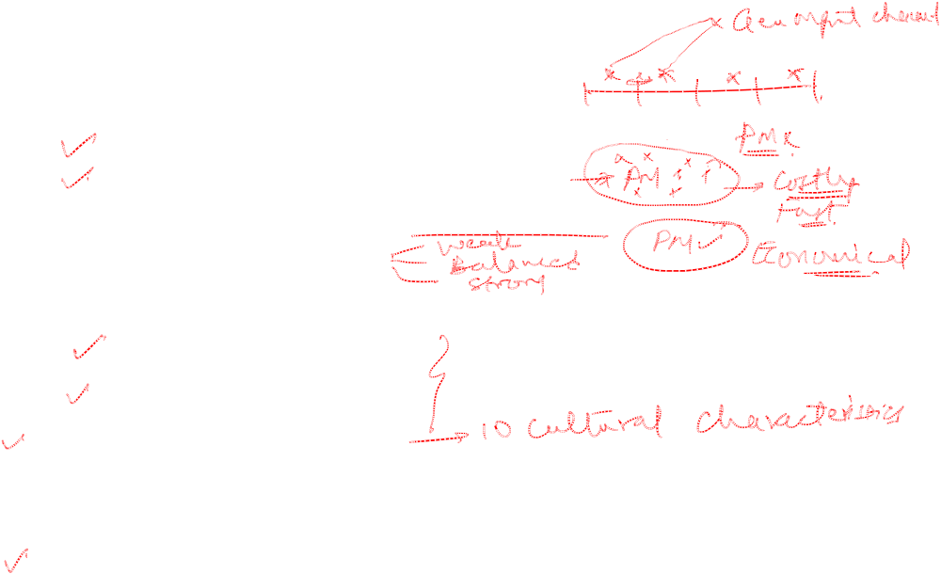
Organization Structure and Culture
Project Management Structures
Organizing Projects within the Functional Organization
Organizing Projects as Dedicated Teams
Organizing Projects within a Matrix Arrangement
Different Matrix Forms
The Right Project Management Structure
Organization Considerations
Project Considerations
Organizational Culture
Implications of Organizational Culture for Organizing Projects
Case 3.1

Slide 4

Different Project Management Structures in Organizations
Traditional Functional Organization
Dedicated Project Teams
Matrix Structure

Slide 5
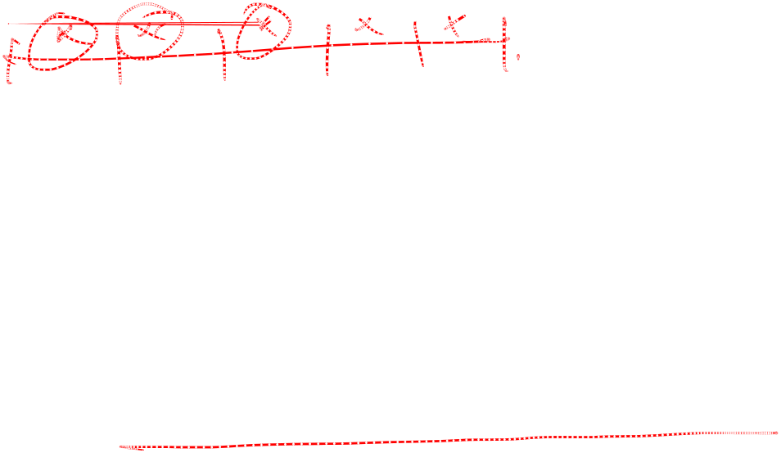
TRADITIONAL FUNCTIONAL ORGANIZATION STRUCTURE
Organizing Projects Within the Existing Functional Hierarchy
Different Segments of Projects are Delegated to Respective Functional Units
Coordination Through General Management Channels
Based on the Nature of The Project, one Functional Area Takes the Lead Role

Slide 6

ADVANTAGES
No Disturbance: Projects are Completed Within the Basic Functional Structure of the Parent Organization Without any Change in Structure and Operation of the Organization
Flexibility: Flexibility in the Use of Staff. Work can be Assigned Temporarily. Staff can be Switched Amongst Different Projects
In-depth Expertise: If the Scope of the Project is Narrow, Functional Areas can have In-depth Study and Knowledge

Slide 7
ADVANTAGES
Easy Post-project Transition: Normal Career Paths Within Functional Divisions are Maintained; Specialists can Advance Their Professional Growth and Advancement

Slide 8

DISADVANTAGES
Lack Of Focus: Each Functional Unit has its own Core Routine Work and Targets. Project Responsibilities are Pushed Aside
Poor Integration: Functional Specialists may be Concerned Only with Their Segment of the Project and Not With What is Best for the Total Project

Slide 9

DISADVANTAGES
Slow: Takes Longer Time to Complete the Projects, Lack of Horizontal, Direct Communication Among Functional Groups. Contributes to Rework
Lack of Ownership: Motivation is Weak. Lack of Ownership Discourages Strong Commitment to Project-related Activities

Slide 10
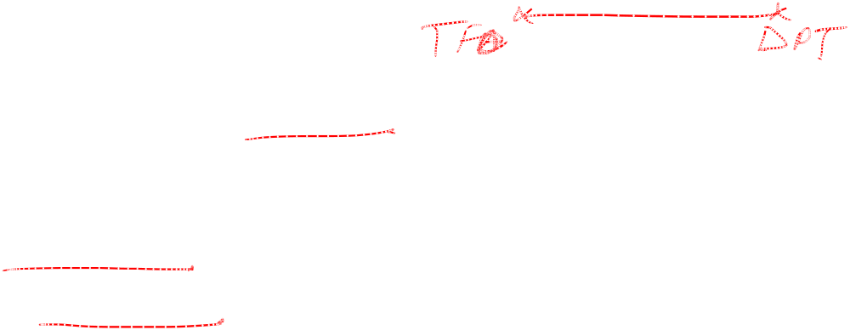
DEDICATED PROJECT TEAM STRUCTURE
Creation of Independent Project Teams
Project Manager Heads the Group of Specialists Who Work Full Time on the Project
Team is Physically Separated From the Parent Organization and Given Marching Orders to Complete the Project

Slide 11

ADVANTAGES
Simple: Functional Organization Remains Intact With Project Team Operating Independently
Fast: Projects Tend to Get Done More Quickly, Response Time is Quicker as Decisions are Made Within the Team
Cohesive: High Level of Motivation and Cohesiveness Emerge Within Project Team as they have Common Goal and Personal Responsibility in Completing the Project
Cross Functional Interaction: Specialists From Different Areas Work Together to Optimize the Project

Slide 12

DISADVANTAGES
Expensive: Duplication of Efforts Across Projects and a Loss of Economies of Scale
Internal Strife: Dedicated Project Teams Take on an Entity of Their Own and a Disease Known as Projectitis (We-they Syndrome)
Limited Technological Expertise: Creating Self- Contained Teams Inhibits Maximum Technological Expertise
Difficult Post-project Transition: Assigning Full-time Personnel to a Project Creates the Dilemma of What to do With Personnel When the Project is Completed

Slide 13

A MATRIX ARRANGEMENT
Hybrid Organizational Form in Which a Horizontal Project Management Structure is Overlaid on the Normal Functional Hierarchy
Two Chains of Command:
  Functional Lines
  Project Lines
Project Participants Report to Both Functional and Project Managers

Slide 14
The Matrix Structure
Optimal Utilization of Resources by having Individuals Work on Multiple Projects as well as Perform Normal Functional Duties
Achieve Greater Integration by Creating and Legitimizing the Authority of a Project Manager

Slide 15

DIFFERENT MATRIX FORMS
Weak Matrix: Balance of Authority Strongly Favours the Functional Managers
Balanced Matrix: Traditional Matrix Arrangement
Strong Matrix: Balance of Authority Strongly Favors the Project Managers

Slide 16
WEAK MATRIX
Functional Managers are Responsible for Managing Their Segment of the Project
Project Manager Acts as a Staff Assistant Who Draws the Schedules and Checklists, Collects Information on Status of Work and Facilitates Project Completion
Functional Managers Call Most of the Shots and Decide Who Does What and When the Work is Completed
Likely to Improve Technical Quality as well as Provide Better System for Managing Conflict Across Projects
Functional Control is Often Maintained at the Expense of Poor Project Integration

Slide 17
BALANCED MATRIX
Project Manager is Responsible for
  Defining What Needs to be Accomplished
  Establishes the Overall Plan for Completing the Project
  Integrates the Contribution of Different Disciplines
  Sets Schedules and Monitors Progress
Functional Managers are Concerned with How it will be Accomplished
  Assigning Personnel and Executing Their Segment of the Project According to Standards and Schedules Set by the Project Manager

Slide 18
STRONG MATRIX
Creates the Feel of a Project Team Within a Matrix Environment
The Project Manager Controls Most Aspects of the Project Including Scope Trade-offs and Assignment of Functional Personnel
Project Manager Controls When and What Specialists Do and has Final Say on the Major Project Decisions
Functional Manager is Consulted on a Need Basis

Slide 19

Advantages and Disadvantages of the Matrix Form
Likely to Enhance Project Integration
Diminish Internal Power Struggles
Improve Control of Project Activities and Costs
Technical Quality may Suffer
Projectitis may Emerge

Slide 20

STRENGTHS OF MATRIX MANAGEMENT
Efficient: Resources can be Shared Across Multiple Projects
Strong Project Focus: Designated Project Manager Responsible for Coordinating and Integrating Contributions of Different Units
Easier Post-project Transition: Specialists Maintain Ties With Functional Groups So That They can Return After Project Completion
Flexible: Flixible Utilization of Resources and Expertise Within the Firm

Slide 21
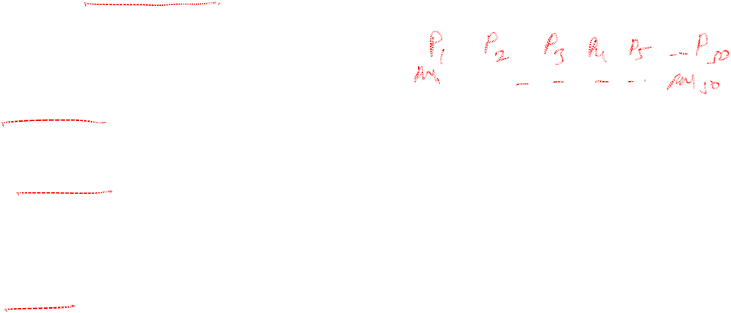
WEAKNESSES
Dysfunctional Conflict: Conflict Between Project and Functional Managers
Infighting: Competition for Scarce Resources
Stressful: Project Participants have Two Bosses: One Project Manager and Another Functional Manager
Slow: Decision Making can be Affected as Agreements have to be Forged Across Multiple Functional Groups, esp. True for the Balanced Matrix

Slide 22
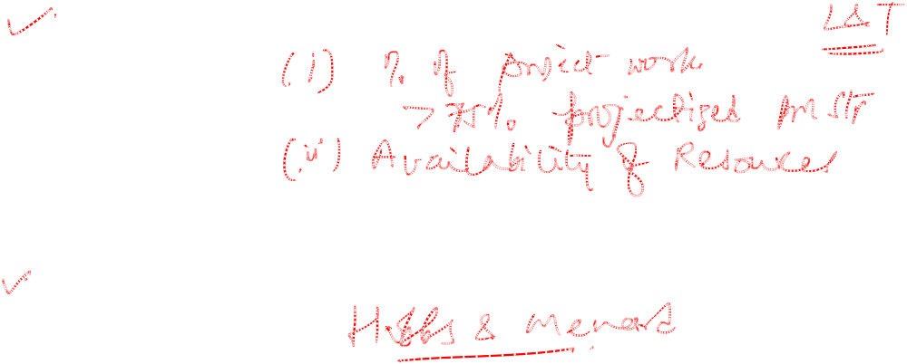
THE RIGHT PROJECT MANAGEMENT STRUCTURE
ORGANIZATION CONSIDERATIONS
PROJECT CONSIDERATIONS

Slide 23
ORGANIZATION CONSIDERATIONS
Percentage of Core Work Involving Projects!
If Over 75% of the Work Involves Projects, then an Organization Should Consider a Fully Projectized Structure
If an Organization has Both Standard Products and Projects, then a Matrix Organization will be more Appropriate
If an Organization has Very Few Projects, then a Less Formal Arrangement is Required. Dedicated Teams Could be Created on an As-Needed Basis, and the Organization Could Outsource Project Work

Slide 24
ORGANIZATION CONSIDERATIONS
Resource Availability!
  If Resources Need to be Shared Amongst Multiple Projects, then Matrix Type is Preferred
  If Critical Personnel can not be Tied up on Individual Projects, then Matrix Type is Preferred
  When Resources are Not Available Internally, then Create a Dedicated Project Team But Outsource Project Work

Slide 25
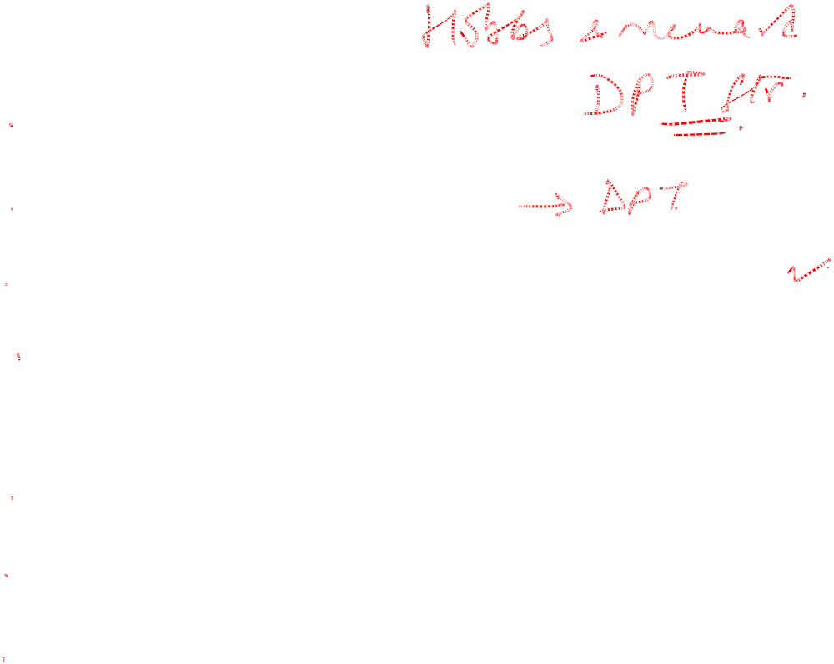
PROJECT CONSIDERATIONS
Size Of Project
Strategic Importance
Novelty and Need for Innovation
Need for Integration (No. of Departments Involved)
Environmental Complexity
Budget and Time Constraints
Stability of Resource Requirements

Slide 26
Project Considerations
Higher the Levels of These Factors, More Autonomy and Authority the Project Manager and Team Need to be Successful
Dedicated Project Teams Should be Used for Urgent Projects in Which the Nature of the Work Requires People Working Steadily From Beginning to End
Creation of a Flexible Management System That Organizes Projects According to Requirements

Slide 27
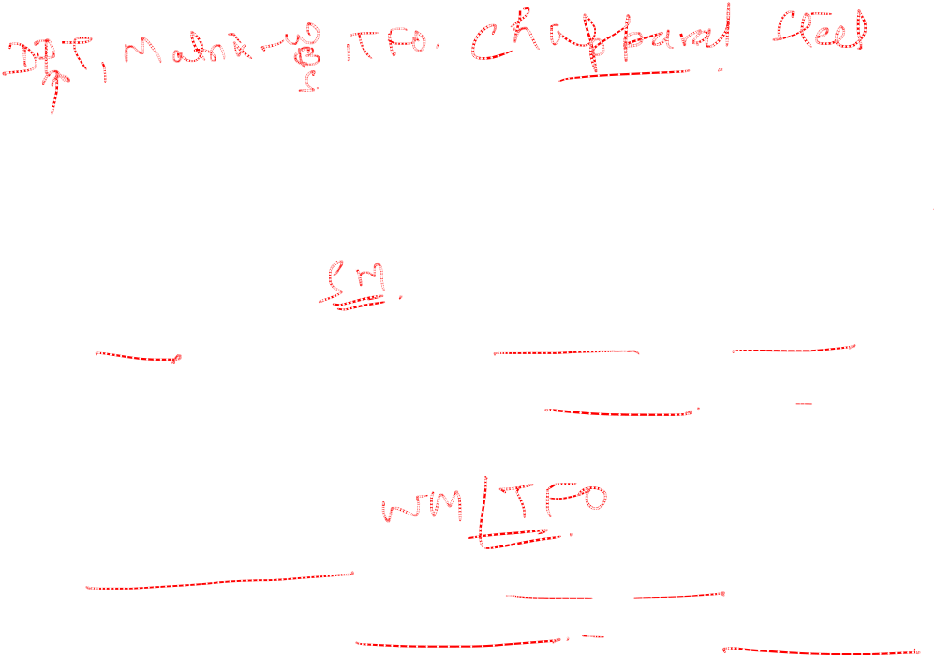
PROJECT TYPES
Advanced Development Projects - High Risk Projects: Involve Creation of a Breakthrough Product or Process
Platform Projects - Medium Risk Projects: Involve System Upgrades That Yield New Products and Processes
Incremental Projects - Low Risk Projects: Involve Minor Adjustments in Existing Products and Processes

Slide 28

ORGANIZATION CULTURE
Refers to a System of Shared Norms, Beliefs, Values and Assumptions which Binds People Together Thereby Creating Shared Meanings
Culture Reflects the Personality of the Organization and is similar to an Individual’s Personality

Slide 29

ORGANIZATION CULTURE
Culture serves the following important functions:
Culture provides a sense of identity to its members.
Culture helps legitimize the management system of the organization.
It clarifies and reinforces standards of behaviour.
Culture helps create social order withing an organization.

Slide 30

CHARACTERISTICS
Member Identity: The Degree to Which Employees Identify With the Organization as a Whole Rather Than With Their Type of Job or Field of Professional Expertise
Team Emphasis: The Degree to Which Work Activities are Organized Around Groups Rather Than Individuals
Management Focus: The Degree to Which Management Decisions Take Into Account the Effects of Outcomes on People Within the Organization
Unit Integration: The Degree to Which Units Within the Organization are Encouraged to Operate in a Coordinated or Interdependent Manner

Slide 31

Characteristics
Control: The Degree to Which Rules, Policies and Direct Supervision are Used to Oversee and Control Employee Behavior
Risk Tolerance: The Degree to Which Employees are Encouraged to be Aggressive, Innovative, and Risk Seeking
Reward Criteria: The Degree to Which Rewards Such as Promotion and Salary Increases are Allocated According to Employee Performance Rather Than Seniority, Favoritism or Other Nonperformance Factors

Slide 32
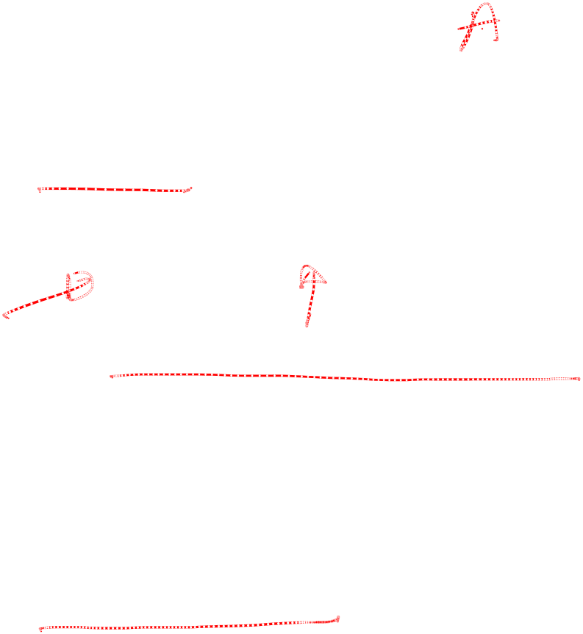
Characteristics
Conflict Tolerance: The Degree to Which Employees are Encouraged to Air Conflicts and Criticisms Openly
Means Versus End Orientation: The Degree to Which Management Focuses on Outcomes Rather Than on Techniques and Processes Used to Achieve the Results
Open-System Focus: The Degree to Which the Orgn. Monitors and Responds to Changes in the External Environment

Slide 33
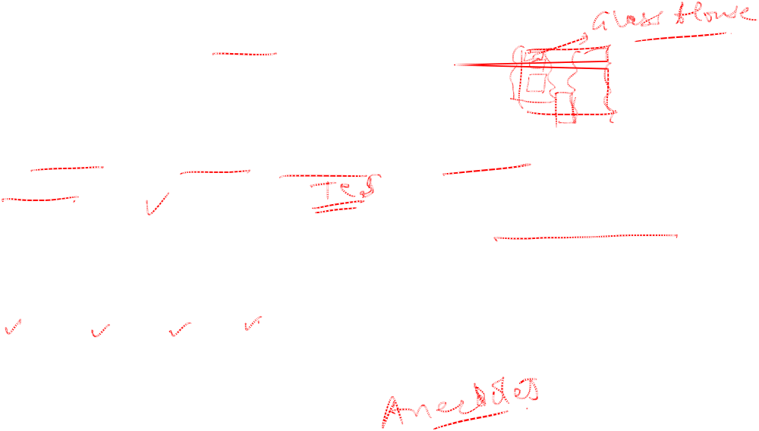
IDENTIFYING CULTURAL CHARACTERISTICS
Study the Physical Characteristics of the Organization
  External Architecture, Offices, Uniform Of Employees
Read About the Organization
  Annual Report, Mission Statements, Press Releases, Internal News Letters
  Concern for People, Concern for Results and the Bottom Line
Observe How People Interact Within the Organization
  Pace, Rituals, Values, Beliefs
  Meetings, Conversation
Interpret Stories and Folklore Surrounding the Organization

Slide 34

Implications of Organizational Culture for Organizing Projects
There are strong relationships among project management structure, organizational culture and successful project management
Greater project authority and time are required to complete projects that encounter a strong, negative cultural current
Conversely, less formal authority and fewer dedicated resources are needed to complete projects in which the cultural currents generate behaviour and cooperation essential to project success

Slide 35
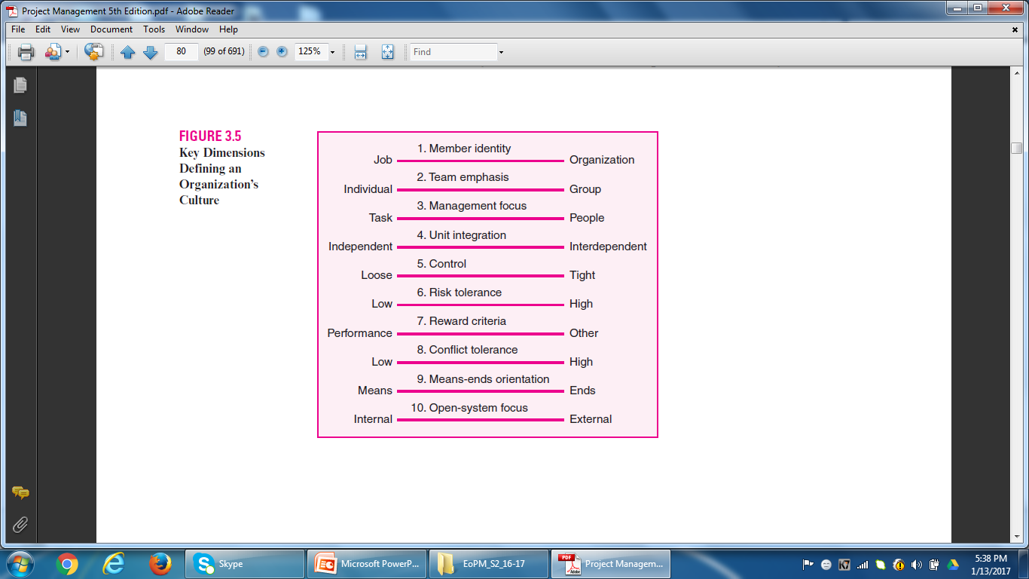
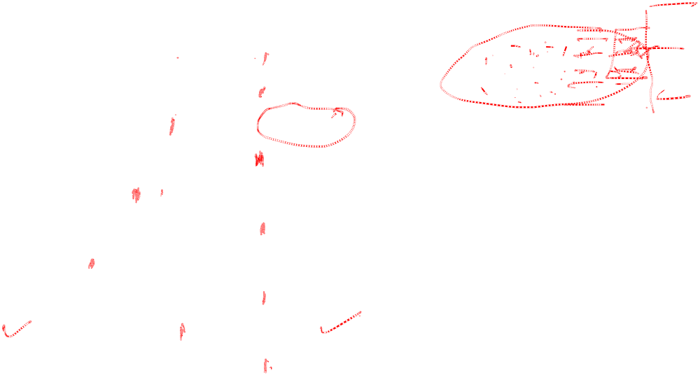
Implications of Organizational Culture for Organizing Projects

Slide 36

Case 3.1
Moss and McAdams Accounting Firm
If you were Palmer at the end of the case, how would you respond?
2. What, if anything, could Palmer have done to avoid losing Olds?
3. What advantages and disadvantages of a matrix type organization are apparent from this case?
4. What could the management at M&M do to more effectively manage situations like this?

Slide 37
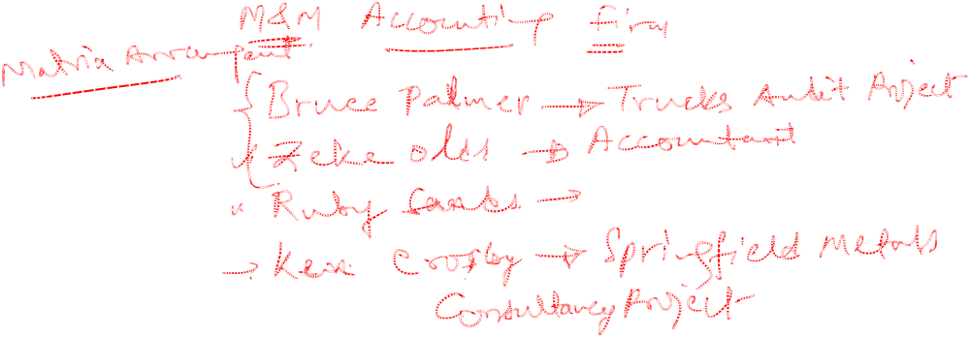

Slide 38
L6 - Project Management
Second Semester 2024-25 (S2-24)
Thank You!
M K Hamirwasia
hamirwasiamk@pilani.bits-pilani.ac.in

